Slide 1
Introduction to Statistics
December 2015

Slide 2



For whom?
Beginner
Value addition in knowledge
Practitioner
Revisions, discussions and clarifications
Expert
Value addition to facilitator’s knowledge

Slide 3

Agenda
Introduction (10:00 to 10:30)
What is Statistics
How different from Mathematics
Types of Data & Statistics (10:30 to 11:30)
Types of Data
Types of Statistics
Population, Sample & Distribution (11:30 to 12:00)
Parameters & Estimates
Sampling distribution
Estimation (12:00 to 12:30)
Properties of estimates – unbiasness & consistency
Degree of Freedom
Testing (12:30 to 01:00)
Hypothesis testing & confusion matrix
Fixed (α) & observed (P-value) significance level
Prediction (02:00 to 04:00)
Simple & Multiple linear regression
R², β’s & significance of variables
Assumptions of Regression
Assessment (04:00 to 04:20)
Discussion & Feedback (04:20 to 04:30)

Slide 4


What’s there
Interesting
Boring
Scene behind the game of stats
Derivations to catch the scene behind the game of stats

Slide 5
What is statistics

Slide 6
What is statistics
Business Problem
Data & Domain
Exploratory Analysis
Statistical approach
Analysis & Modeling
Results & Inferences
Forecast next month interest rate
Macroeconomic variables - GDP, Unemployment rate
Visualization of time series
Regression and time series modeling
Significance of variables on interest rate
Forecast the rate
Data
(Historical values of Interest rates)
Information
(Trend of Interest rates)
Knowledge
(Plan the investment according to the interest rate)
Tomato’s price at various markets of Bengaluru
Average price of tomato in Bengaluru as high as INR 60/kg
Let’s use 1 tomato in today’s Rassam instead of 2
Statistics
Applied mathematics
Methodology for collecting, analyzing, interpreting and drawing conclusions from information.

Slide 7
Mathematics Vs Statistics
Mathematics | Statistics
Weight = 2 x Age | Weight = 2 x Age + ε
Deterministic- No randomness | Probabilistic- Captures the randomness
Deals with the relation between variables | Deals with the data & relation between variables

Slide 8
Types of Data & Statistics

Slide 9
Types of Data used in statistics
Data
Quantitative
(Numbers)
Qualitative
(Not numbers)
Discrete (Countable & Finite)
Continuous (Uncountable/ Infinite): Height, Length, Weight
Binary (0-1)
Integer (No. of employees)
Ordinal (Employees’ JL)
Nominal (Employees’ Name)
Categorical (Employees’ Unit)
Cross-sectional (Age of infoscions as of now) | Longitudinal (Daily stock price)

Slide 10
Types of Statistics
Descriptive
Summary of observations
Central tendency- mean, mode, median
Dispersion- standard deviation, variance of employees’ age
Predictive
Forecasting & prediction
Predicting weight of an employee based on given age
Forecasting Stock price of Infosys
Prescriptive
Optimizing and prescribing the best alternative
Operations research, Linear programming
Job allocation to employees

Slide 11
Population, Sample & Distribution

Slide 12


Population & Sample
Average age of Infoscions?
Take a sample from classroom at Infosys
Population | Sample
Set of objects in which we are primarily interested during our research problem | Set of objects which we experiment with during our research problem
Hypothetical (often) | Practical
Characteristics Parameters are constant but unknown that we need to find (Average age will be a single constant value, but do we get that?) | Characteristics Statistics are estimates of the parameters of population; they vary as sample changes (Different class rooms will give different average age)

Slide 13
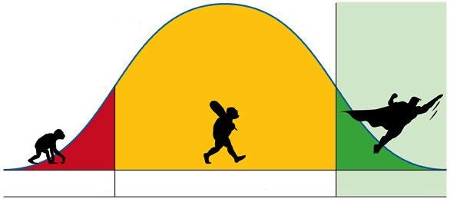
Sampling Distribution
Age range | No. of Infoscions | Probability
20-25 | 8 | 0.03
25-30 | 22 | 0.08
30-35 | 34 | 0.13
35-40 | 40 | 0.15
40-45 | 54 | 0.20
45-50 | 45 | 0.17
50-55 | 30 | 0.11
55-60 | 20 | 0.08
60-65 | 12 | 0.05
Total | 265 | 1
Bell curve -> Normal distribution
Has the parameters mean & standard deviation
Sampling Distribution
Probability Mass Function (PMF)-in discrete data & Probability Density Function (PDF)-in continuous data
Captures the randomness in the data by summarizing them in a distribution

Slide 14
Estimation

Slide 15
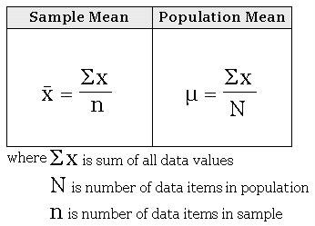
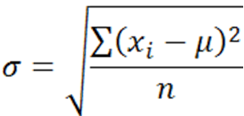
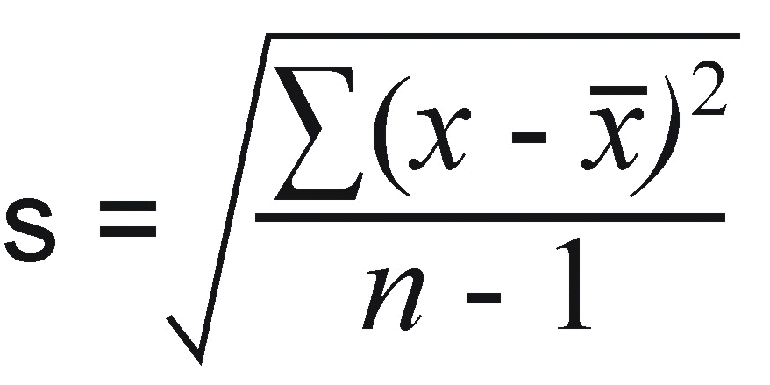
Estimation
‘Process of approximation of population parameter using sample’
Properties of ‘best’ estimator
Consistent - As sample size increases estimator should come closer to population parameter
θ_hat --> θ (when n increases)
Unbiased – Expectation of estimator should be equal to population parameter
E[θ_hat] = θ
Why Mean is the best estimator?
Exercise
 | Population | Sample
Mean
Standard Deviation
MS Excel command | “=STDEV.P()” | “=STDEV.S()”
Why ‘n-1’ instead of n?
If population mean is 30 & given sample size is 5 then how many observations you can select freely?
(Degree of Freedom)
Exercise

Slide 16
Testing

Slide 17
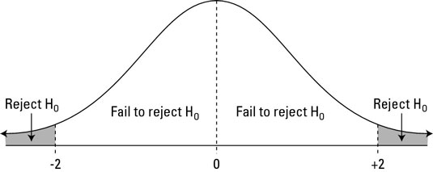
Hypothesis Testing
Hypothesis testing is the use of statistics to determine the probability that a given hypothesis is true.
Formulate the null hypothesis H0 (status quo) & alternate hypothesis Ha (to be tested, in general)
Is average age of Infoscions is > 30 years?
H0: Average age of Infoscions µ0 <=30
Ha: Average age of Infoscions µ0 > 30
Identify a test statistic that can be used to assess the truth of the null hypothesis
Assume: Sampling distribution is Normally distributed & observed mean age is 40 years with 5 years SD
Find the corresponding quantile of standard normal distribution i.e. test statistics
Zobs= Point Estimate / Standard Error = (Xobs - µ0)/σ = (40 - 30)/5 = 2
Compute the P-value, which is the probability that a test statistic at least as significant as the one observed would be obtained assuming that the null hypothesis were true. Smaller the P-values the stronger the evidence against the null hypothesis.
P(Z>=2) = 2.28%
Only 2.28% probability that observed sample (Xobs) will fall under H0
But it may be that Xobs belongs to H0 actually; in that case you are committing Type-I error
If this error (2.28%) is affordable to you (less than your fixed threshold level α)
Take the risk and reject H0 ☺

Slide 18
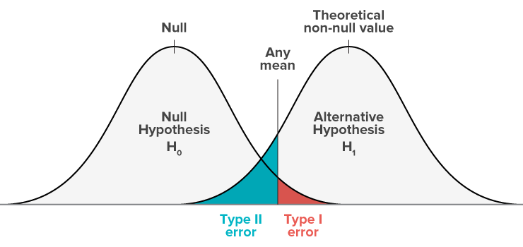
Hypothesis Testing
 |  | Decision
 |  | Accept H0 | Reject H0
Reality | H0 true | ☺ | Type-I error (α)
 | H0 false | Type-II error (β) | ☺
Type-I error is more dangerous than Type-II error so it should be as small as possible
But there is trade-off: Decreasing Type-I error increases Type-II error
Benefit of doubt goes to Null
 |  | Decision
 |  | Prisoner should be acquitted | Prisoner should be hanged
Prisoner is not guilty | H0 true | ☺ | Innocent is hanged ☹
 | H0 false | Criminal is acquitted ☹ | ☺
If P-value < α: Acceptable level of error; Reject H0
Exercise

Slide 19

Lunch-Break

Slide 20
Prediction

Slide 21
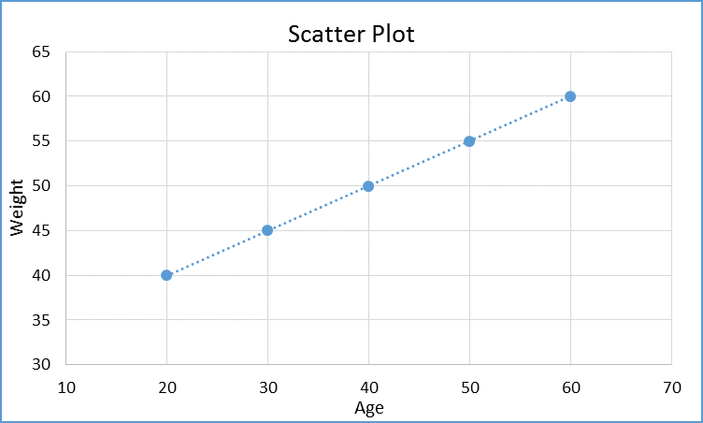
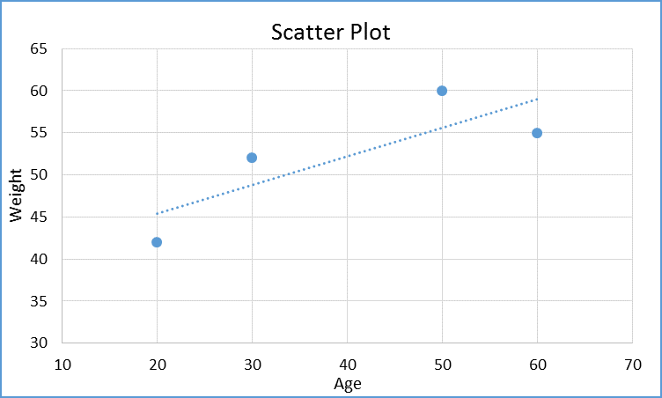
Prediction
Age | Weight
20 | 40
30 | 45
40 | ?
50 | 55
60 | 60
Age | Weight
20 | 42
30 | 52
40 | ?
50 | 60
60 | 55
70 | ?
?
?
Interpolation (linear)
X-45 = [(55-45)/(50-30)]*(40-30)
X = 50
Mathematics
No equation that contains dependent & independent variables
Limitations
Can’t capture the non-linear association
Unreliable extrapolation
Remedy
Generalize the relation between dependent & independent variables by an equation - Regression
Find out the ‘best’ fit line that ‘best’ describes the association between variables and can be used for prediction

Slide 22
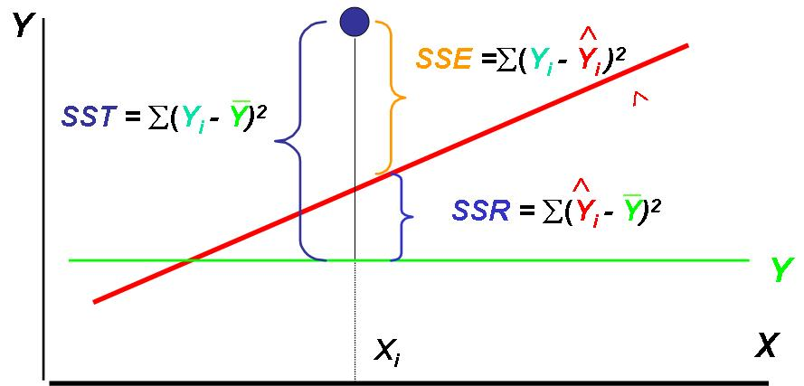
Regression (a conditional expectation E[Y/X] )
Regression equation
Y: Dependent Variable
X: Independent variable
Regression Model
Actual
Y=β0 + β1*X + ε
OR
Estimate
Ӱ = β0 + β1*X
Residual/Error: Y – Ӱ = ε
(Y)
(X)
Exercise
Objective
To find out ‘best line’ i.e. optimum values of β0 & β1 that minimizes sum square of error
OLS (Ordinary Least Square)
Degree of determination (fitness of the model)
R² = SSR / SST = SSR / (SSR + SSE)
We expect
SSE SSR R²
Ref: http://www2.warwick.ac.uk/fac/soc/economics/staff/vetroeger/teaching/po906_week567.pdf

Slide 23
Regression- some more
Regression Variables
Dependent variables- Repressors
Independent variables - Regressand
Basic type of regression
Based on no. of independent variables:
Simple linear
Multiple linear
Based on no. of target variable :
Univariate (only 1 target variable)
Multivariate (more than 1 target variable)
Based on no. of power of β:
Linear regression (power of β=1)
Non-linear regression
Based on the conditional distribution
Parametric (if Y|X~N[µ,σ])
Non-parametric
Assumptions of Regression
Variables should be stationary
Samples should be i.i.d.
Conditional distribution i.e. Y|X~N[µ,σ]
Conditional variance i.e. σ should be constant (Homoskedastic)
(Last 2 are chicken-egg problem since these are tested on residuals and residuals only come when you build the model. If the test fails then you have to re-build the model ☹ )
Have we understood?
R²
Interpreting β’s
Significance of the variables
Exercise- simple & multiple regression

Slide 24
Forecasting (Time Series)

Slide 25
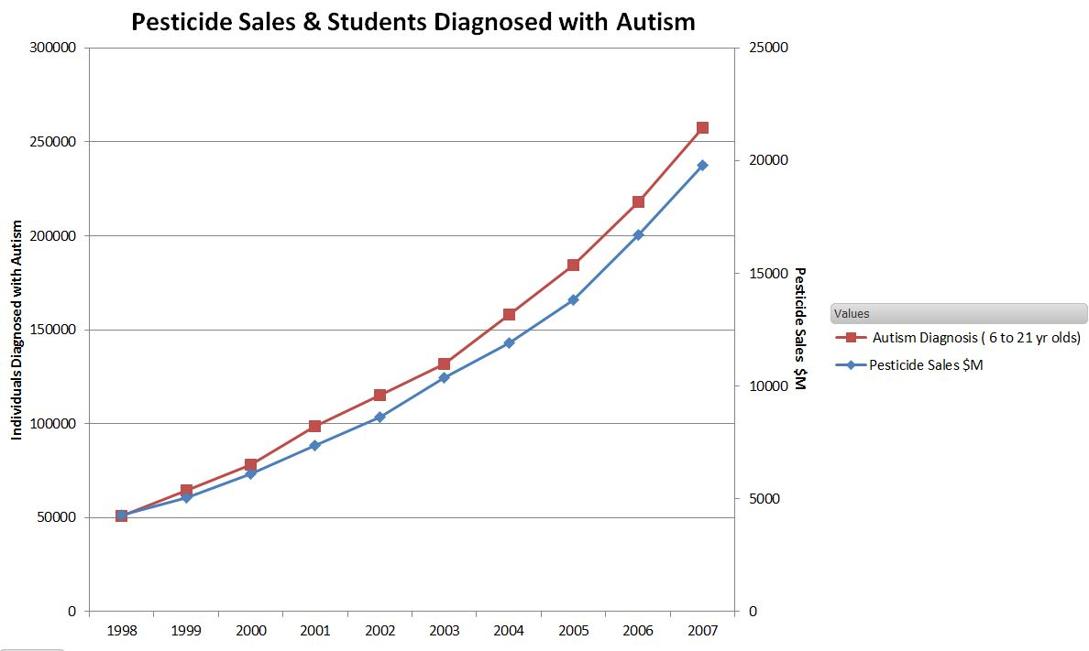
Time Series Analysis & Forecasting
Spurious Regression
Autoregression
ARIMA Model

Slide 26
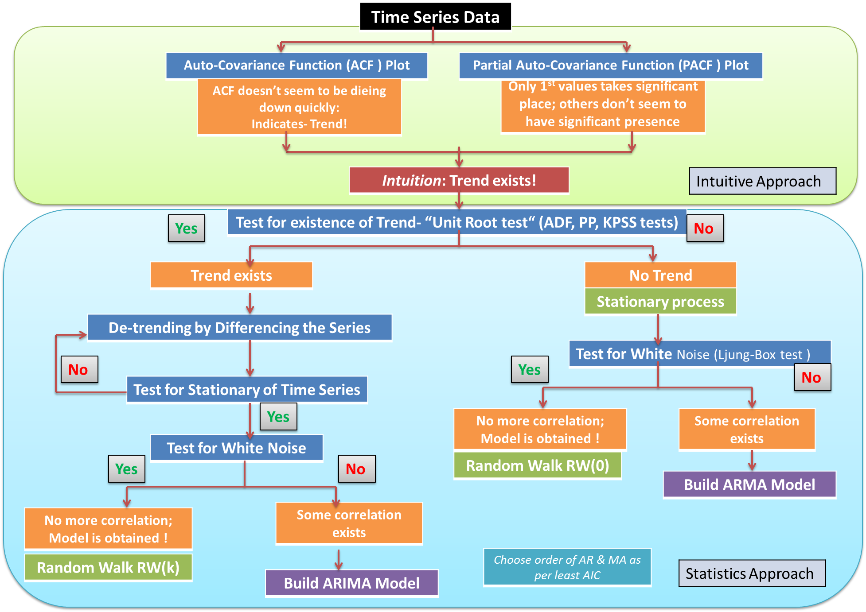
Time Series Approach

Slide 27
Discussion on Assessment

Slide 28
Discussion on Assessment
Statistics is:
Application of mathematics
To deals with capturing the randomness in the observation & thereby generating conclusion
Both
Answer: C
Method of linear interpolation without any set equation is………….. & with a certain fixed equation is……………………..:
Mathematics, Statistics
Statistics, Mathematics
Both
Answer: A

Slide 29
Discussion on Assessment
Employees’ name (Ram, Mohan) is ………………….., Salary of Infoscion (7.15, 8, 8.25, 22.5 LPA) is …………….., Job level of Infoscion (Rank i.e. JL-2, 3, 4, 5) is …………….
Discrete, Continuous, Nominal
Nominal, Continuous, Ordinal
Categorical, Discrete, Ordinal
Answer: B
Mean of Infoscions’ age (35 YEARS) is ………………….. statistics, computing their salary as per age (2 LPA per year) is ………. Statistics and optimum job allocation based on their age & expertise is (Specialized in Analytics should join DNA for best utilization & revenue maximization) ………….
Descriptive, Predictive, Prescriptive
Prescriptive, Predictive, Descriptive
Predictive, Prescriptive, Descriptive
Answer: A

Slide 30
Discussion on Assessment
Following is the characteristics of a population and is constant but unknown that a statistics tries to capture using sample:
Estimate
Parameters
Standard Error
Answer: B
“Distribution” is the plot refers to:
Histogram
Bar chart
Probability Density Function (PDF)
Answer: C

Slide 31
Discussion on Assessment
If the mean sum of square of 10 Infoscions’ age is 900 then standard deviation of this “sample” is ……………… and degree of freedom is………….
10, 9
10, 10
9, 10
Degree of freedom = 10-1 =9
SD of sample = √(mean sum of square / DoF) = √(900/9) = 10
Answer: A
Type-I error (α) in hypothesis testing is:
You do not reject null hypothesis when it is true
You reject null hypothesis when it is true
You reject do not null hypothesis when it is not true
Answer: B

Slide 32
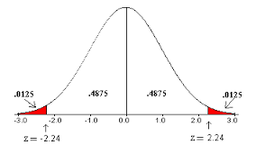
Discussion on Assessment
For deciding “how large is large?” or “significance” of certain estimates, we need:
Sampling distribution, Point estimate, standard error
Sampling distribution, Point estimate
Sampling distribution, standard error
Answer: A
In regression model where ‘Salary’ (in INR) is dependent & ‘Age’ (in years) is independent variable, unit of measurement for coefficients β0 & β1 are respectively:
β0: Year; β1: Year/INR
β0: INR; β1: Year
β0: INR; β1: INR/Year
Salary = 3 + 2*Age + ε
Answer: C

Slide 33
Statistics in our life!

Slide 34



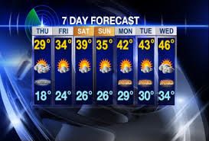
Statistics in our life!
Starting the weekend with the “Null Hypothesis” that there is holiday today
Estimating the hour to reach office from home, considering Bengaluru traffic (exogenous variable) ☹
Knowingly or unknowingly, Statistics with us!
Let’s understand & exploit it to make the things better!
Predicting the workload of the day based on your performance & workload of the team (Independent variables) ☺
Forecasting or referring to weather forecast to plan your exit from office ☺

Slide 35
Thank You

